Slide 1
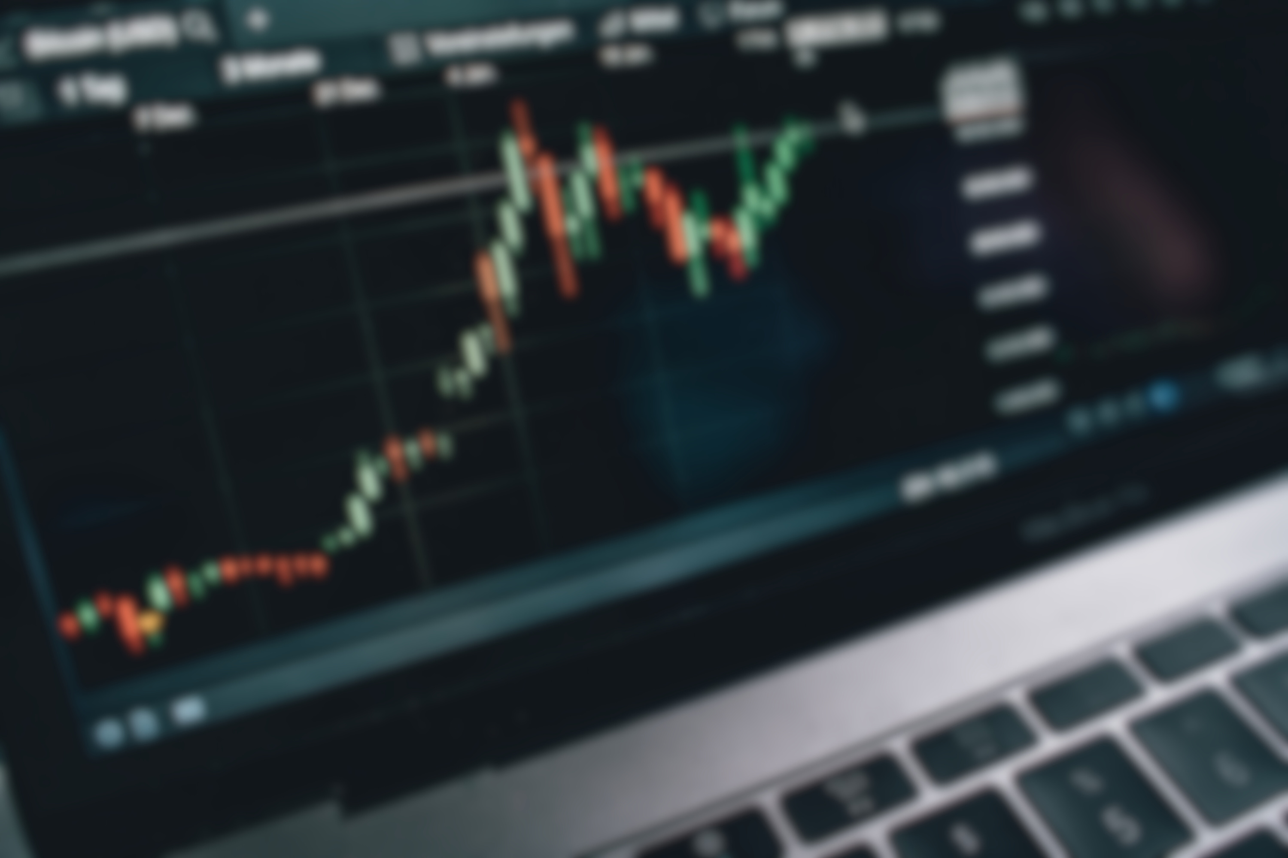


Bull Sight
AI-Powered Stock Market Prediction
& Investment Analysis
“Predicting Tomorrow’s Market, Today.”
By:-
Jefrin Issac - 44611068
Jeyakant M. - 44611070
Harshath M.P.- 44611060
Harish S. - 44611057
Shyam E. - 44611052

Slide 2
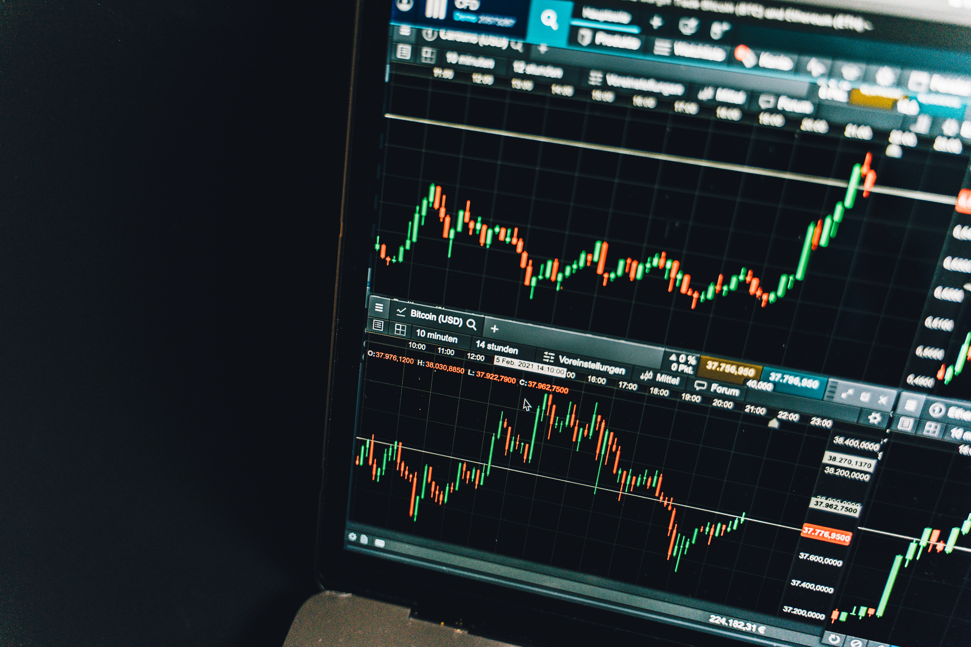

Agenda
  Introduction
  Problem Statement
  Existing System
  Proposed System
  Working of the Proposed System
  Objectives
  Scope of the Project
  Dataset
  Data Preprocessing
  Data Flow
  Machine Learning Models
  System Architecture
  Methodology
  Tools & Technologies
  Expected Results
  Conclusion

Slide 3

Introduction
The stock market plays a vital role in the global economy by enabling companies to raise capital and investors to grow their wealth. However, stock prices fluctuate continuously due to various factors such as market trends, economic conditions, company performance, and investor sentiment.
Traditional methods of stock analysis require extensive knowledge and experience, making it difficult for many investors to make informed decisions.
Bull Sight is an AI-powered stock market prediction system that uses historical stock data and Machine Learning algorithms to forecast future stock prices. By analyzing market trends and technical indicators, the system provides intelligent predictions and investment insights to support better decision-making.

Slide 4
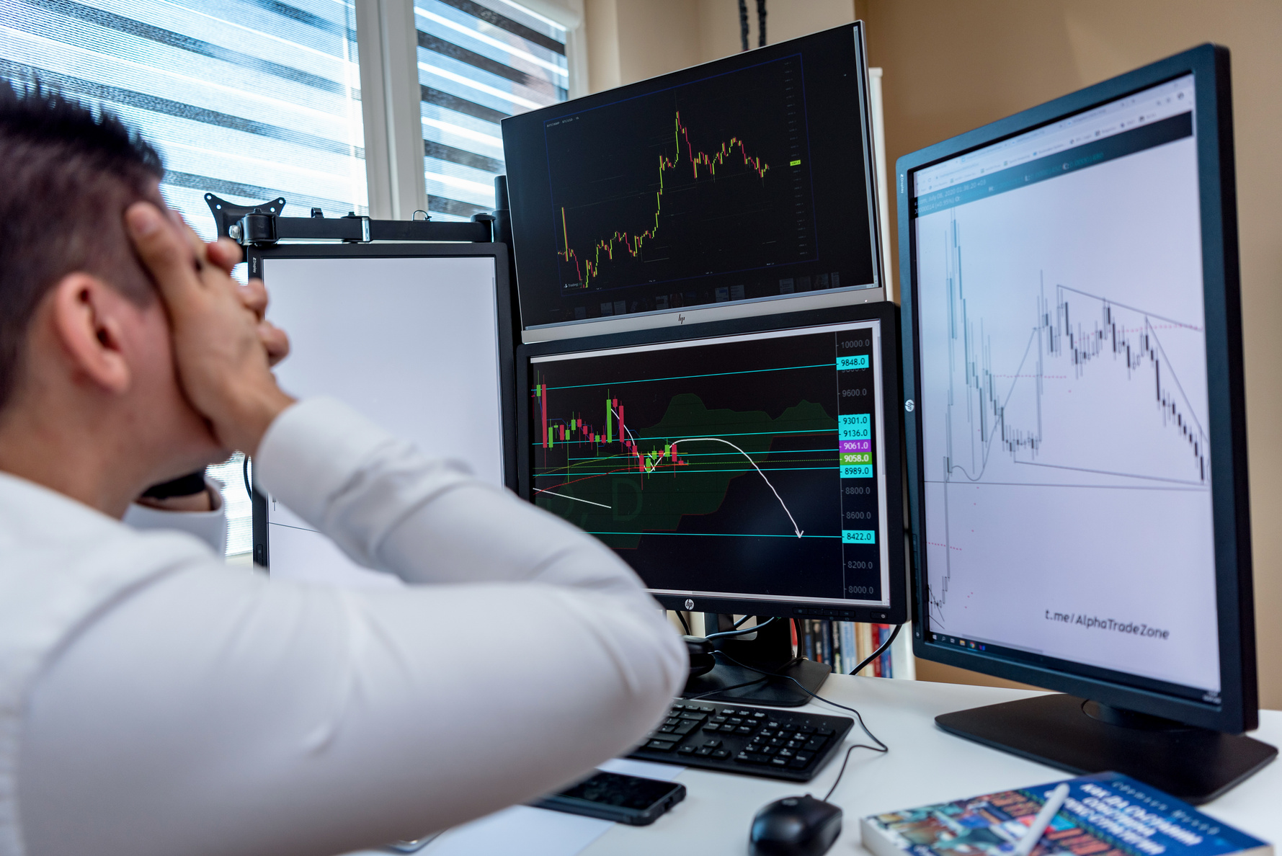

Problem Statement
Predicting stock market prices is a complex task due to the dynamic and volatile nature of financial markets. Traditional prediction methods often rely on manual analysis, which is time-consuming and prone to errors. Investors need a reliable system that can analyze large volumes of historical market data and identify patterns to forecast future stock prices accurately.
Bull Sight aims to address this challenge by leveraging Machine Learning techniques to analyze historical stock data, technical indicators, and market trends, providing accurate predictions and helping investors make informed investment decisions.

Slide 5



Existing System
Currently, stock market analysis is primarily performed using traditional methods such as Technical Analysis, Fundamental Analysis, and manual market observation. Investors often rely on historical price charts, company financial reports, market news, and expert opinions to make investment decisions. While these approaches provide valuable insights, they require significant expertise and may not always produce accurate predictions due to rapidly changing market conditions.
Methods Used in Existing Systems
Technical Analysis
Fundamental Analysis
  Studies historical price movements and trading volumes.
  Uses indicators like Moving Average (MA), RSI, and MACD.
  Evaluates a company's financial health.
  Considers revenue, profit, assets, and market performance.
News & Expert Analysis
Limitations of Existing System
  Relies on financial news, analyst reports, and market trends.
  Predictions may vary based on individual opinions.
  Time-consuming and requires expert knowledge.
  Prone to human errors and emotional bias.
  Difficult to analyze large volumes of market data.

Slide 6
Proposed System
Bull Sight is an intelligent stock market prediction system that uses Machine Learning to analyze historical stock market data and forecast future stock prices. The system processes historical prices, technical indicators, and market trends to generate accurate predictions and assist investors in making informed investment decisions.
Unlike traditional methods, Bull Sight automates data analysis, minimizes human effort, and provides real-time insights through an interactive dashboard.
Key Features
Advantages Over Existing System
  AI-powered stock price prediction.
  Analysis of historical market trends and technical indicators.
  Machine Learning models for accurate forecasting.
  Interactive dashboard with graphical visualization.
  AI-powered automated analysis
  Fast and efficient
  Improved prediction accuracy
  User-friendly for everyone
  Real-time visualization and recommendations

Slide 7
Working of the Proposed System
  Collect historical stock market data.
  Clean and preprocess the dataset.
  Extract important technical indicators.
  Train Machine Learning models.
  Predict future stock prices.
  Display results through an interactive dashboard.

Slide 8

Objectives
Predict future stock prices using Machine Learning algorithms.
Perform efficient data preprocessing for improved prediction accuracy.
Compare multiple Machine Learning models to identify the best-performing model.
Provide Buy, Hold, or Sell recommendations based on predictions.
Develop an interactive dashboard for visualizing stock trends and prediction results.
Help investors make informed, data-driven investment decisions.

Slide 9
Scope of the Project
Integration with real-time stock market data.
News sentiment analysis using NLP.
Mobile application support.
Advanced Deep Learning models (LGRU, Transformers, etc,).
Real-time stock price alerts and notifications.
Support for multiple global stock exchanges.

Slide 10

Dataset
The performance of Bull Sight depends on the quality of the historical stock market data used for training and testing the Machine Learning models. The dataset consists of daily stock market records collected from reliable financial sources.
Dataset Source
Data Used For
  Yahoo Finance (yfinance API)
  Kaggle Stock Market Datasets
  Trend Analysis
  Data Preprocessing
  Machine Learning Model Training

Slide 11
Data Preprocessing
Data preprocessing is a crucial step in developing an accurate stock price prediction model. Raw stock market data often contains missing values, inconsistencies, and noise that can affect the performance of Machine Learning models. Therefore, the data is cleaned and transformed before training.
Steps Involved
Data Cleaning
Feature Selection
Data Normalization
Date Formatting
Technical Indicator Generation

Slide 12
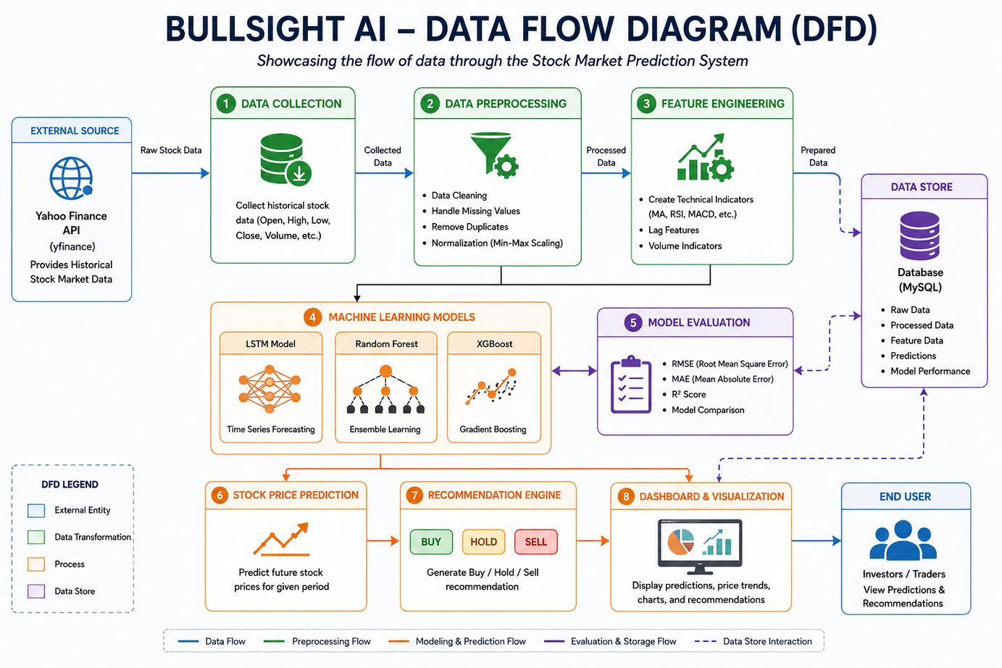
Data Flow Diagram
The Data Flow Diagram (DFD) illustrates how data moves through the Bull Sight system—from collecting historical stock market data to generating predictions and investment recommendations.

Slide 13
Machine Learning Models
Bull Sight uses Machine Learning algorithms to identify patterns in historical stock market data and predict future stock prices. Different models are trained and evaluated to determine which one provides the most accurate predictions.
Models Used
Linear Regression
Random Forest
A simple predictive model that establishes a linear relationship between historical stock data and future prices. It serves as a baseline model for performance comparison.
An ensemble learning algorithm that combines multiple decision trees to improve prediction accuracy and reduce overfitting.
XGBoost
LSTM (Long Short-Term Memory)
A gradient boosting algorithm known for its high speed and excellent prediction performance on structured datasets.
A deep learning model specifically designed for time-series forecasting. It captures long-term dependencies in sequential stock market data, making it highly suitable for stock price prediction.

Slide 14
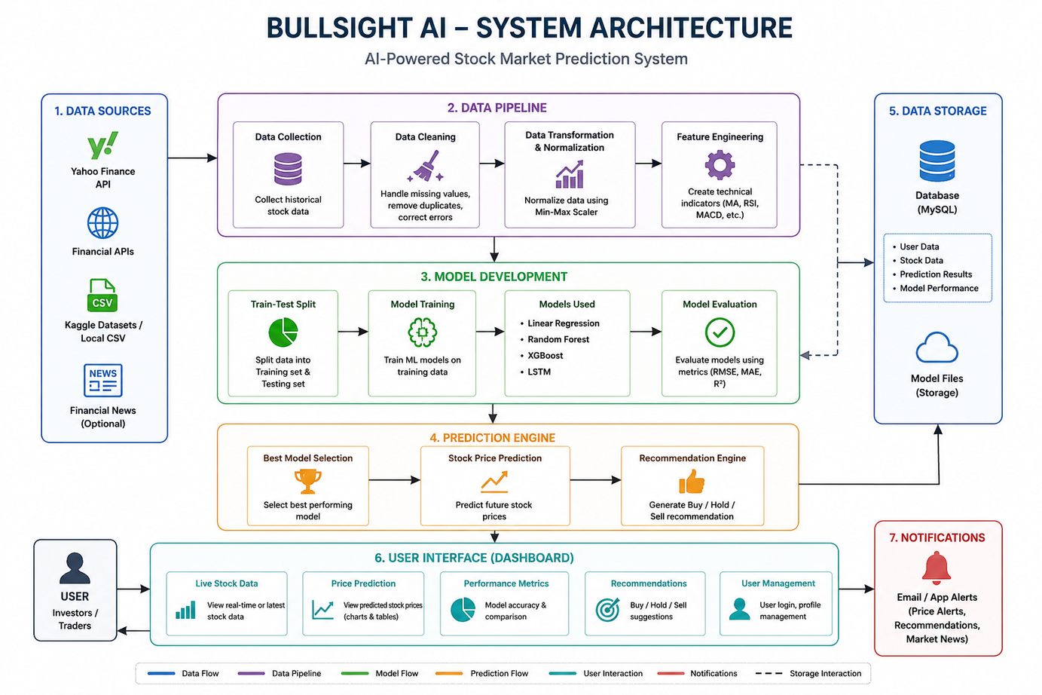
System Architecture
The BullSight AI system follows a structured workflow to predict future stock prices using Machine Learning. It begins with collecting historical stock market data, followed by preprocessing and feature engineering to prepare the data for model training. The trained model then generates stock price predictions, which are displayed to the user through an interactive dashboard.

Slide 15
Tools & Technologies
BullSight AI is developed using modern technologies for data collection, machine learning, backend processing, frontend visualization, and database management. These tools work together to build an efficient and user-friendly stock market prediction system.
Category
Technology
Frontend
React.js
Backend
FastAPI / Flask
Database
MySQL
IDE
Visual Studio Code
API
Yahoo Finance (yfinance)

Slide 16
Expected Results
Bull Sight is expected to accurately predict future stock prices by analyzing historical market data using Machine Learning algorithms. The system will help investors understand market trends and make informed investment decisions through an interactive dashboard.
Intelligent analysis using Machine Learning algorithms.
Accurate prediction of future stock prices.
Interactive dashboard with graphs and market trends.
Faster and more reliable investment decision support.
Buy / Hold / Sell recommendations based on predictions.
Reduced manual effort in stock market analysis.

Slide 17
Advantages
Accurate Stock Price Prediction:
  Uses Machine Learning algorithms to improve prediction accuracy.
Fast Data Analysis:
  Processes large volumes of historical stock data in a short time.
AI-Powered Decision Support:
  Provides intelligent insights based on market trends and technical indicators.
Investment Recommendations:
  Generates Buy, Hold, or Sell suggestions to support investors.
Interactive Dashboard:
  Displays predictions, trends, charts, and performance metrics in a user-friendly interface.
Reduced Human Error:
  Minimizes manual analysis and emotional bias in investment decisions.
Scalable & User-Friendly:
  Can be enhanced with real-time data, news analysis, and additional stock exchanges in the future.

Slide 18
Milestones Achieved
  Finalized the project title, problem statement, and objectives.
  Conducted a literature survey on stock market prediction using Machine Learning.
  Selected the Yahoo Finance dataset and identified key stock market attributes.
  Selected Machine Learning algorithms including Linear Regression, Random Forest, XGBoost, and LSTM for model comparison.
  Designed the System Architecture Diagram and Data Flow Diagram (DFD).
  Finalized the technology stack (Python, Pandas, NumPy, Scikit-learn, TensorFlow, React, MySQL).

Slide 19
Conclusion
BullSight AI is an AI-powered stock market prediction system designed to analyze historical stock market data and forecast future stock prices using Machine Learning techniques. By combining data preprocessing, feature engineering, and predictive models, the system aims to provide accurate forecasts and assist investors in making informed investment decisions.
The project focuses on improving prediction accuracy, reducing manual analysis, and presenting meaningful insights through an interactive dashboard. With future enhancements such as real-time data integration and sentiment analysis, BullSight AI has the potential to become a powerful decision-support tool for investors.

Slide 20
Thank You

